Slide 1

Object Oriented Discrete-Event Simulation CS 4632
Department of Computer Science
College of Computing and Software Engineering
Kennesaw State University

Slide 2
Simulation Model
Built from the conceptual model of a system.
Implemented in an appropriate programming or simulation language.
Is needed to mimic the behavior of the real system under certain constraints.

Slide 3

Development of Simulation Models
Two main objectives:
To study some relevant aspects of the dynamic behavior of a system
To estimate various performance measures of the system

Slide 4

Simulation Run
A simulation run is an experiment carried out for some observation period using the simulation model to study (predict) the behavior of the system.

Slide 5
Simulation Language
The advantages and disadvantages of an object-oriented simulation programming language compared to an integrated icon-based simulation tool are:
Flexibility with modularity
Power of the simulation language
May be more difficult to use than an integrated simulation tool.

Slide 6
System Components
Active (or live) components: the processes. These are the major components in a model and have a life of their own.
Passive components:
Explicit and implicit queues
Resources that can be acquired by the processes.

Slide 7
Using A Simulation Model
A user must be allowed to:
01
Manipulate the model by supplying it with a set of inputs
02
Observe its behavior or output
03
Predict the behavior of the real system by analyzing the behavior of the model
04

Slide 8

Supporting Software
The simulation executive. The program that controls every simulation.
The set of utility functions for housekeeping tasks.
Reporting simulation trace and output statistics

Slide 9
Facilities Provided by Simulation Software
Maintain the sequence of event records (pairs of event and event time)
Provide mechanisms for the generation and cancellation of event records
Maintain the simulation clock
Provide functions to generate random numbers from common probability distributions

Slide 10

The Time Dimension
Simulation time, the time referenced by executing simulation models. This time is advanced by:
Fixed time increments
Variable time increments (event scan)
Run time, the absolute time referenced by the OS while a program executes.

Slide 11
World View with Discrete-Event Simulation
Event approach
Activity approach
Process interaction approach

Slide 12
The Process Interaction
A simulation model consists of a description of how processes (active entities) are going to interact among themselves, as time passes.
Also includes a description of passive objects
A simulation run consists of creating and starting the processes interacting among themselves, synchronizing and using resources.

Slide 13
Advantages of the Process Style of Simulation
Compatible with the Object-Oriented approach to modeling and programming, every process is an active object.
Suitable for modeling large and complex systems.
C++, C#, Java, and any higher-level object-oriented simulation language are used to implement the models.

Slide 14
Processes
Processes are active objects implemented as threads in C#, Java, and C++.
The main body in a thread consists of a set of instructions and calls to various functions (or methods)
The general behavior of a thread is defined in class Process of the OOsimL language.

Slide 15

Process View
Static Process Description
Dynamic Process Management
Initiate Process
Delay (Time) Process
Suspend Process
Activate Process
Terminate Process

Slide 16
Resource View
Resource Management
Resource Creation and Acquisition:
Create resource
Request resource
Acquire resource
Standard/Tailored Resource Handler
Resource Handling: Release resource
Destroy resource
Resource Status:
Status of resource

Slide 17
Simulation Executive
Schedule processes at instants, i.e., place processes in the event list
Remove processes from the event list ( to make them idle or to terminate them)
Re-schedule processes, i.e., change position of processes in the event list.
Execute the “running” process.

Slide 18
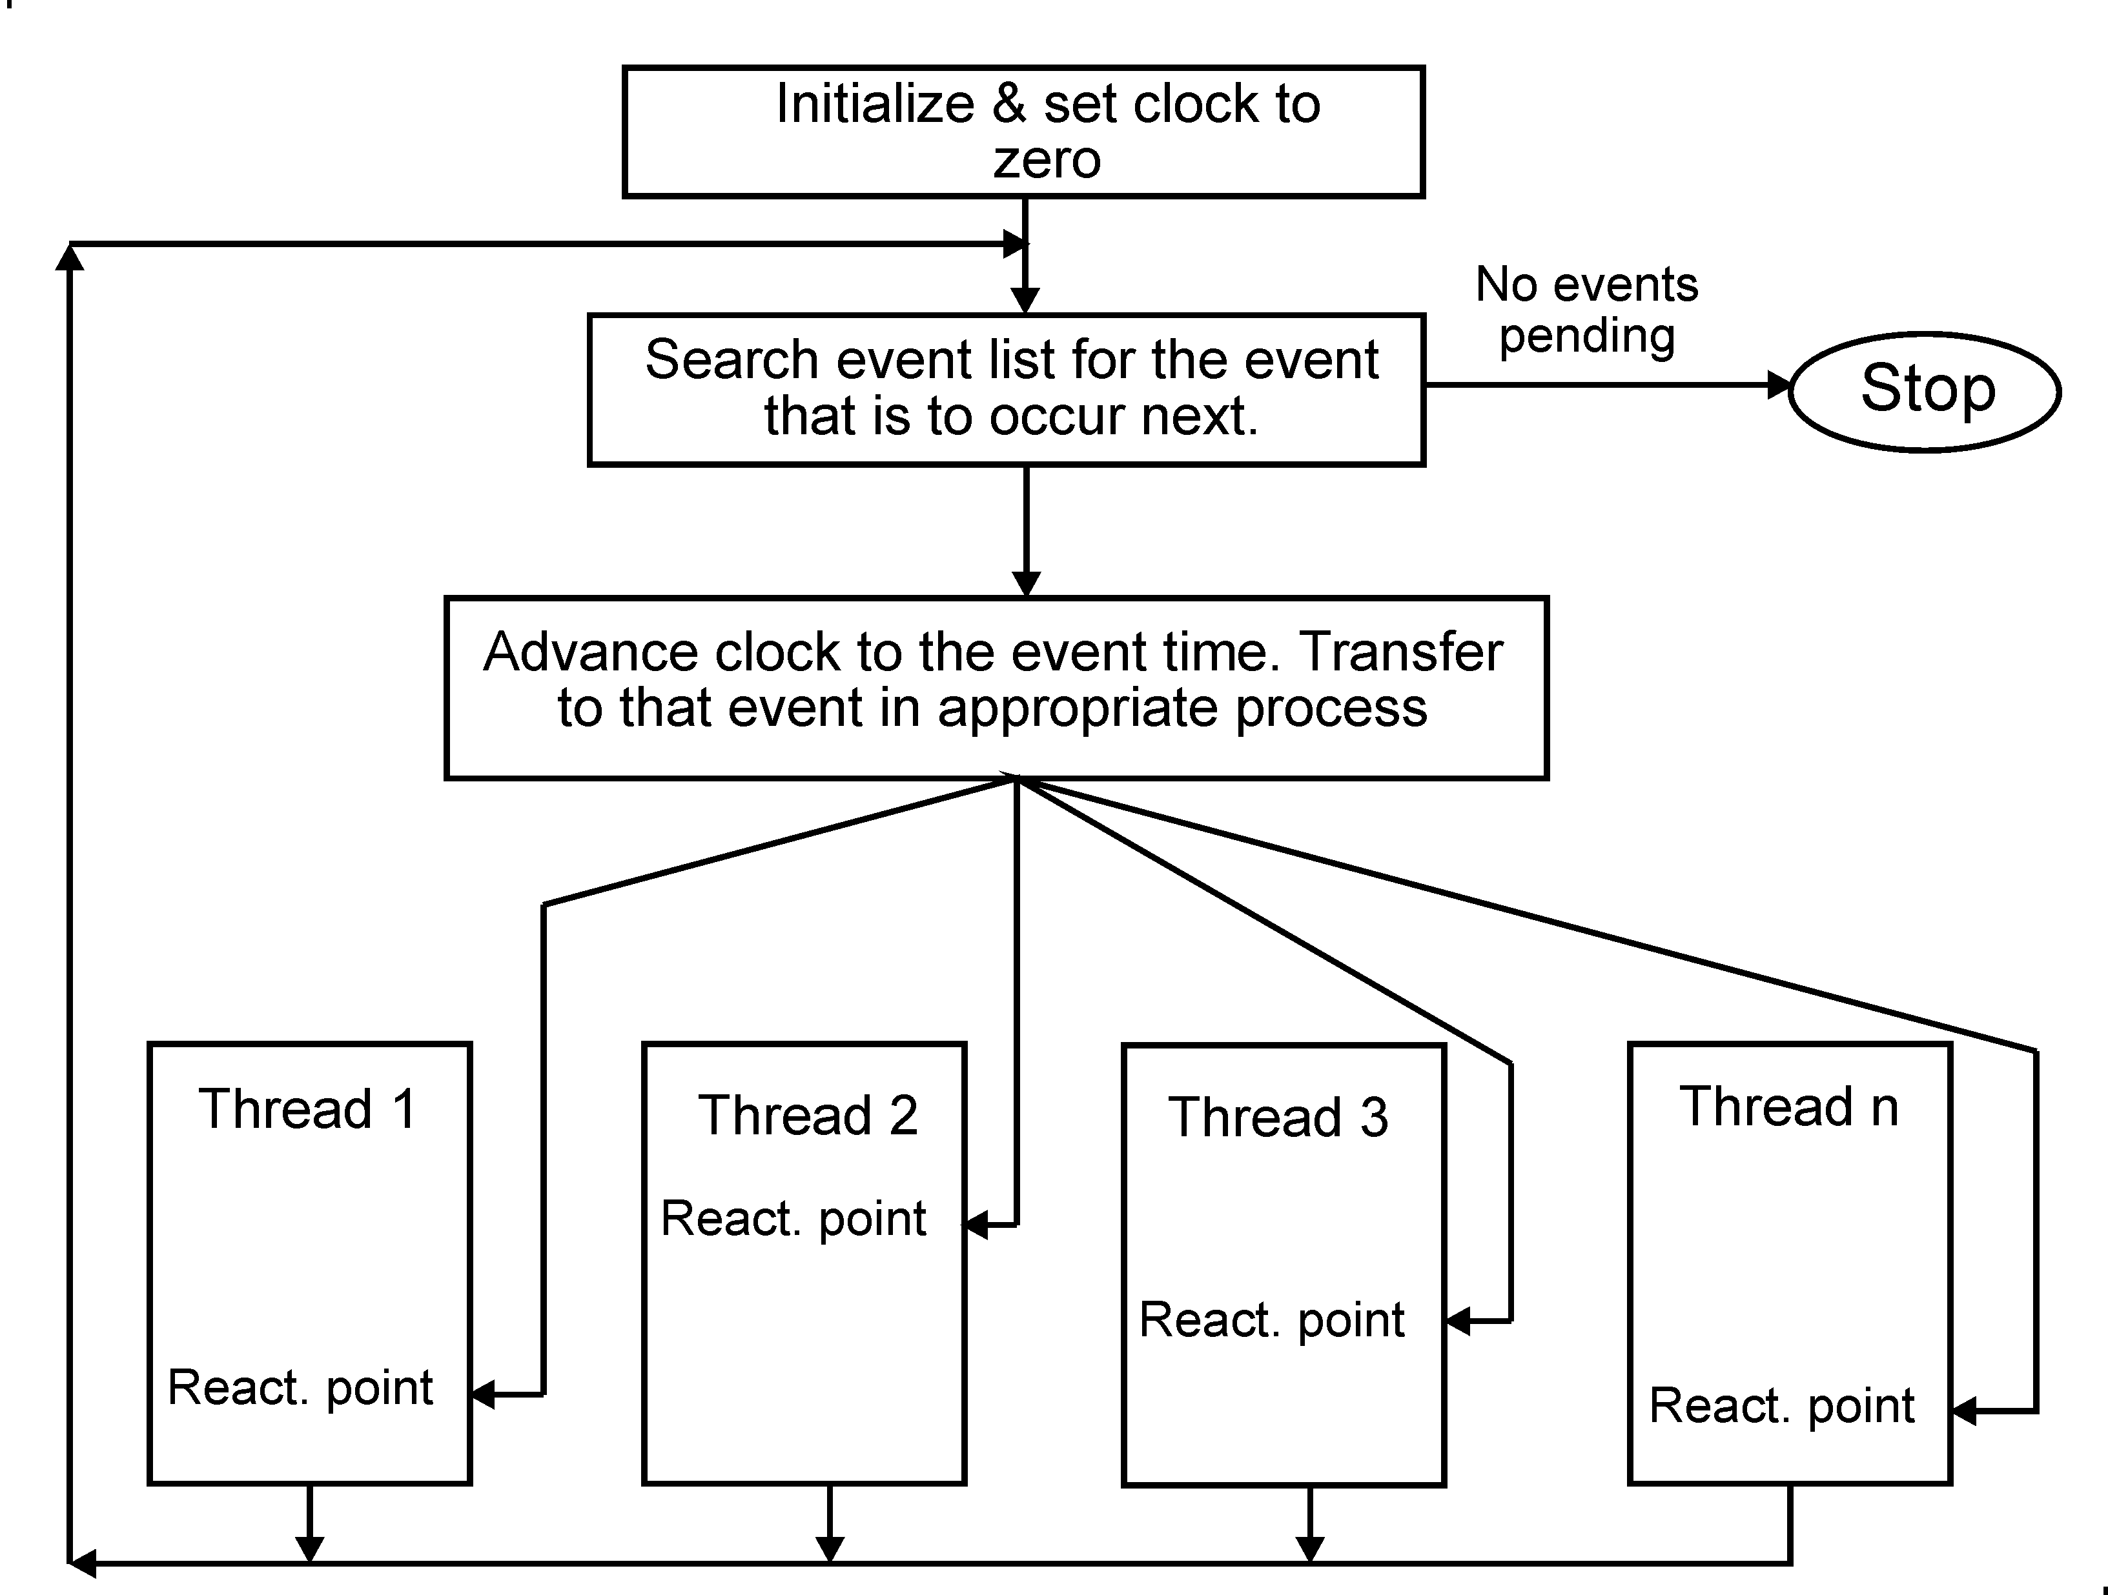
The Simulation Executive

Slide 19
Threads
A thread is an independent execution sequence of an application that may interact with other threads
A thread is executed and controlled by the simulation executive
The threads of a model are executed concurrently

Slide 20
Overview - Levels of Abstraction
In modeling a system, different levels of abstraction are used to describe the system
The most abstract level is at the top (high), and it is the easiest to understand
The most difficult level of abstraction is the implementation level, i.e., the programming of the model into a suitable simulation programming language.

Slide 21
Overview (cont.)
Together with abstraction, the object-oriented approach is applied to deal with complexity, at all levels of abstraction
C#, Java, and C++ are high-level OO programming languages and are convenient and powerful for implementing simulation models
A simulation language is considered higher-level

Slide 22
Process Interaction Simulation
The major components in a model are active and passive entities
The active entities are called processes and have a life of their own
The passive entities are resources and queues
The processes interact among themselves and use resources

Slide 23
The Structure of a Model
Definition of all classes for the various active objects (processes)
These classes inherit the library class Process.
Definition of the class (model class) for the process that represents the model
Method main with instructions that start the simulation

Slide 24
The Main Class in a Model
Every model includes a main class (the model main class). In method main:
Assigns the values for the relevant simulation parameters
Set up Simulation with the title of the model.
Create all the passive objects used in the model.
Create and start the main active object

Slide 25
Main Body
In the method Main_body of the main class
Create and start the other active objects (processes) of the model
Start the simulation, then calculate and output the summary statistics.

Slide 26

General Class Structure
class < class_name > as process is
private, protected, public data definitions
private, protected, public methods
endclass < class_name >

Slide 27
General Structure of a Class
class Server as a process is
private
// private data definitions
protected
// protected data definitions
public
// public data definitions
// private, protected, and public methods
End class Server

Slide 28
Data Definitions
Data must be defined in the following order:
Constants
Variables
Object references

Slide 29
Methods or Functions
function initializer
parameters serv_name of type string
is
begin
call super using serv_name
...
endfun initializer
//
function Main_body is
...
begin
. . .
call get_name of machine return value to machine_name
. . .
endfun Main_body
// other public members

Slide 30

Setting Up and Starting a Simulation
define simperiod = 345.5 of type double
...
define run of class Simulation
. . .
simulation title “Carwash Model"
...
start simulation with simperiod

Slide 31
Hold (delay) a Process
In process-oriented simulations, it's often necessary to introduce delays to simulate real-world time passage. The following code demonstrates how to pause the execution of a process.
Example: In a manufacturing simulation, holding a process can represent the time it takes for a machine to finish processing a part.
The following lines of code hold the execution of the current process for a time interval, task_dur.
define task_dur of type double // Declares the duration variable
hold self for task_dur // Holds the process for a specified duration
hold self for 2.35 // Holds the process for a fixed time of 2.35 units

Slide 32

Queuing Models
Models that include at least one queue
The queue is a data structure that stores waiting customers
The server removes from the queue the next customer to service

Slide 33
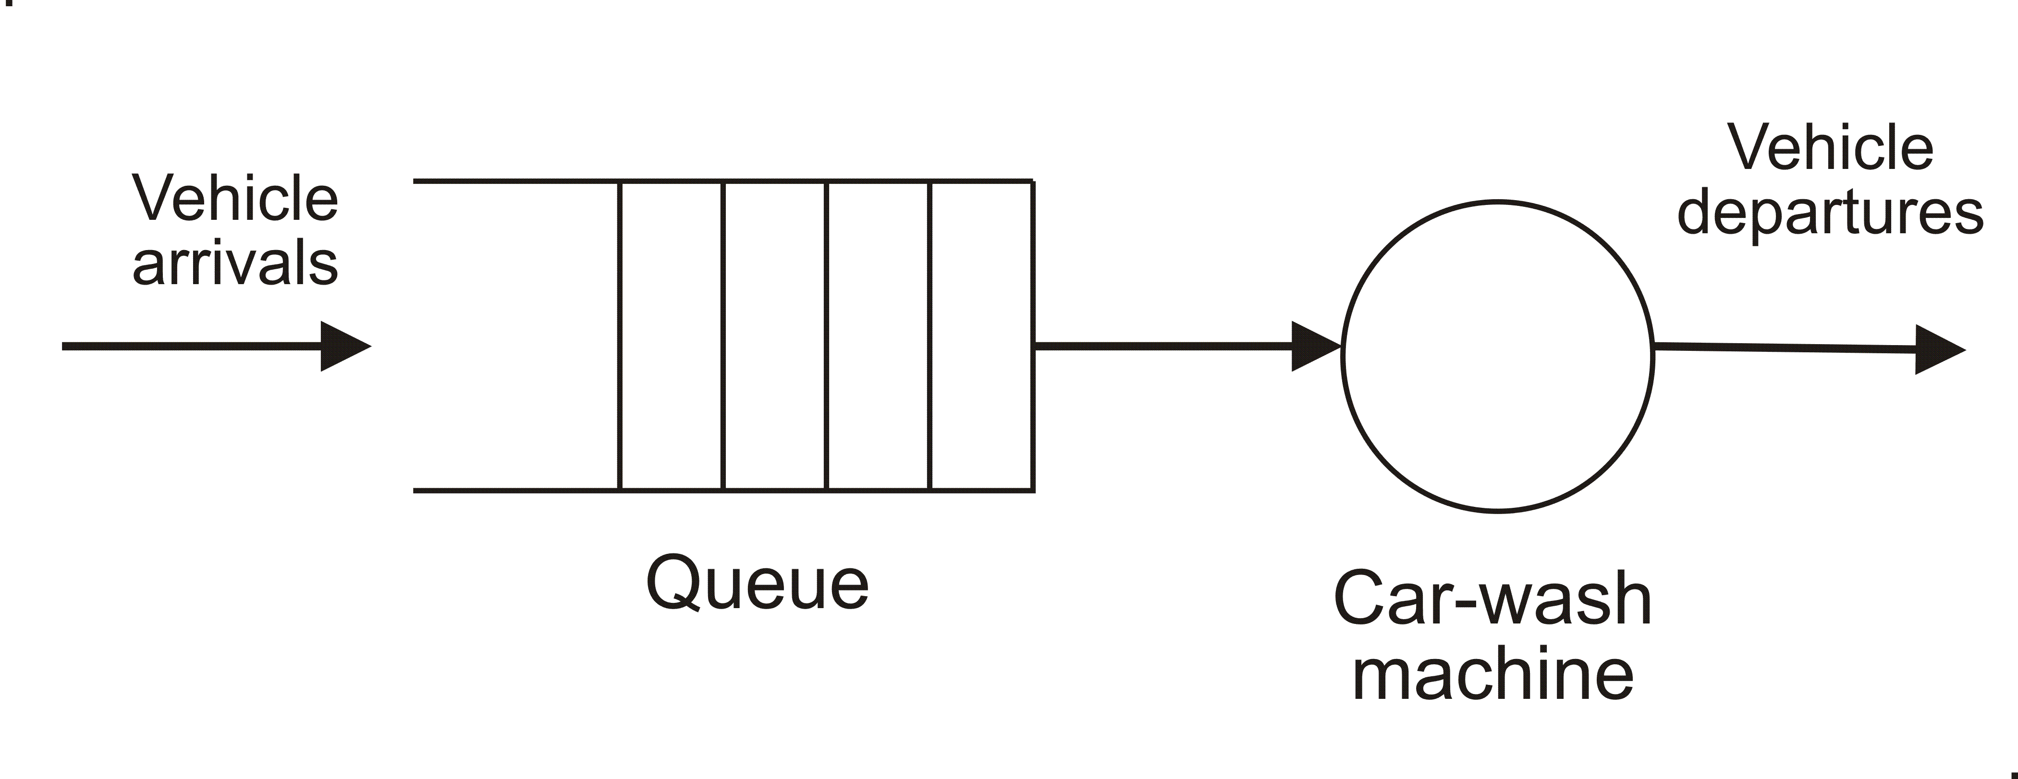
Carwash Model – Single-server

Slide 34
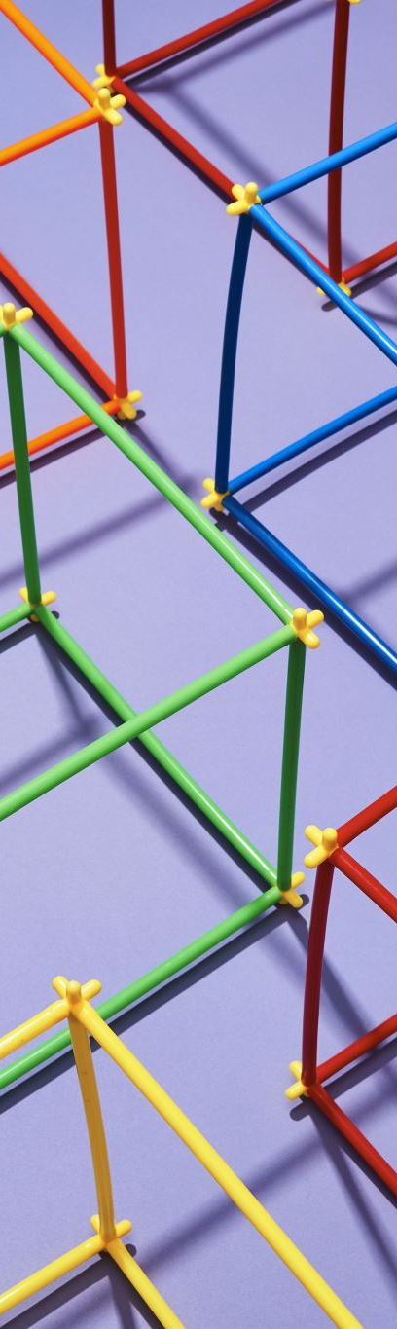
Basic Categories of Queuing Models
Single-server models
Multi-server models
Queuing networks
Multi-server, multi-queue with priorities
Multi-server, multi-queue with priorities and preemption.

Slide 35
Examples of Queuing Models
Computer systems
Communication systems, networks
Teller facilities in a bank
Production systems
Transport and materials handling
Repair and maintenance systems

Slide 36

Service Stations
A queuing model consists of several facilities and interconnecting queues. Each facility, or service station, consists of one or more servers.
For these types of systems, it is very common in practice to use exponential distribution for inter-arrival periods and service periods.

Slide 37

Multiple Servers Single Queue
Any of the servers available can provide service demanded by a customer
A server removes the next customer from the head of the customer queue
One or more servers can be idle, waiting for customers to arrive

Slide 38
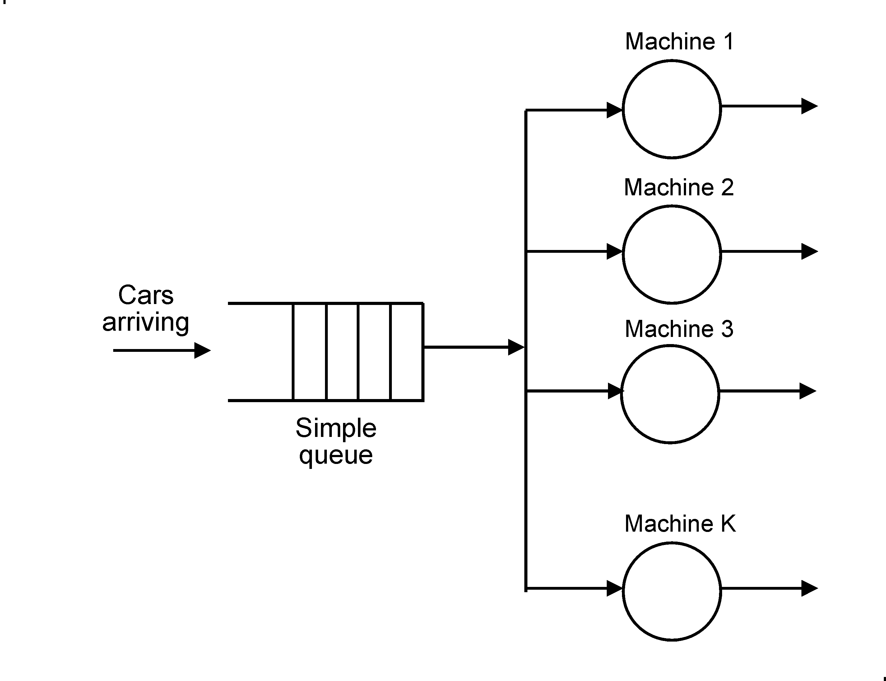
Carwash Model With Multiple Machines

Slide 39
General Description of the Model
This model has K machines (servers)
A customer can receive service from any machine (any server)
A customer waits in the customer queue until it is at the head of the queue and a machine becomes available
The machine removes the customer from the head of the queue and starts to service it

Slide 40
Idle Servers
Idle servers are organized in a server queue
A server joins a queue of idle servers if there are no customers.
An arriving customer enters the input queue and reactivates the server at the head of the server queue. If there are no servers available, the customer just waits.

Slide 41
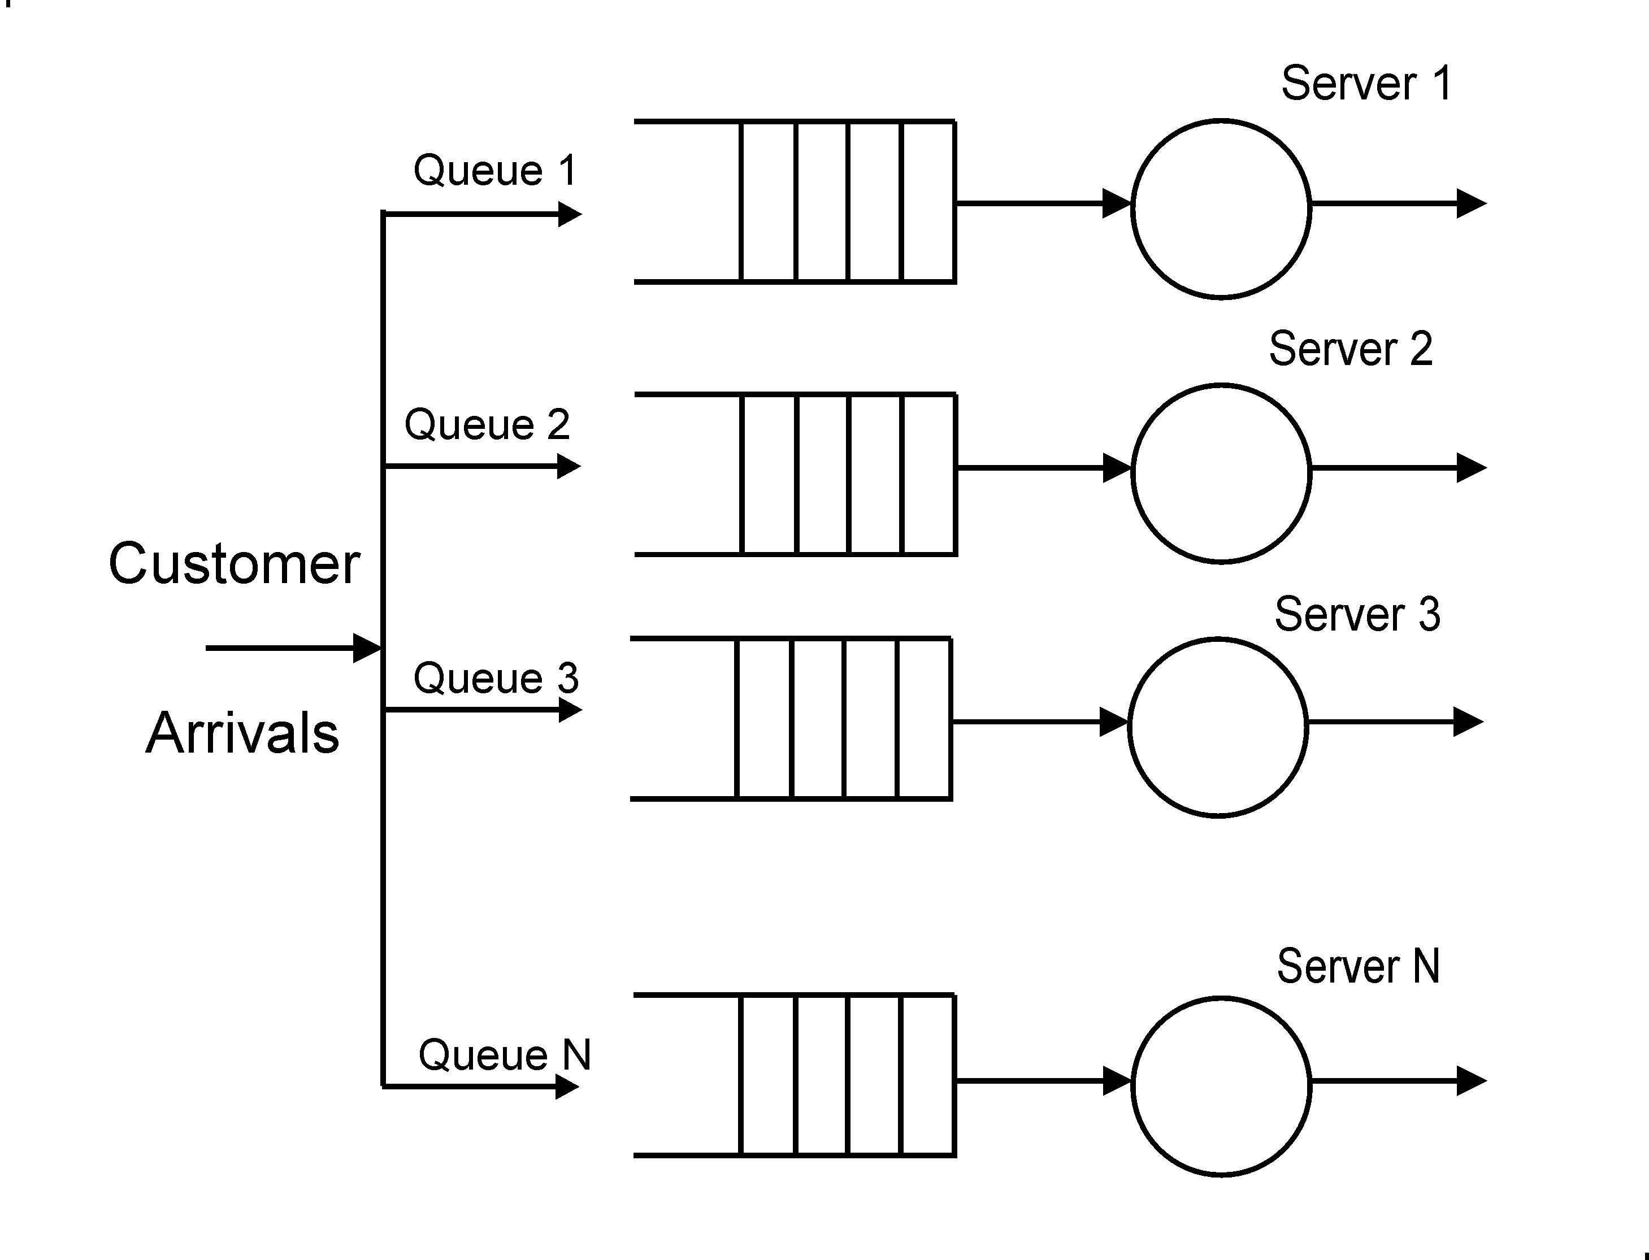
Models With Multiple Servers and Multiple Queues

Slide 42
Multi-Server Multi-Queue Model
Every server has a queue of its own for customers
An arriving customer selects the server with the smallest queue
Alternatively, an arriving customer randomly selects a server.

Slide 43
Multi-Server Multi-Queue Model with Preemption
Every customer has a priority.
An arriving customer can interrupt the service of another customer with a lower priority.
the interrupted customer is returned to its queue, this customer is the one with the lowest priority and that started most recently.

Slide 44
Performance Measures
The average number of customers in the system
The average number of customers in the queue(s) (i.e., that are waiting)
The average time that a customer spends in the system
The average time that a customer spends in the customer queue waiting
The server(s) utilization

Slide 45
Queuing Networks
Consists of two or more interconnected stations
Each station provides a different service
The output from a station are connected to input of another station
Each station has one or more servers and its queues

Slide 46
Service in a Queuing Network
Customers enter the network at any of several entry stations
Customers are routed through the network demanding service from different stations
Customers can exit from any of several exit stations

Slide 47
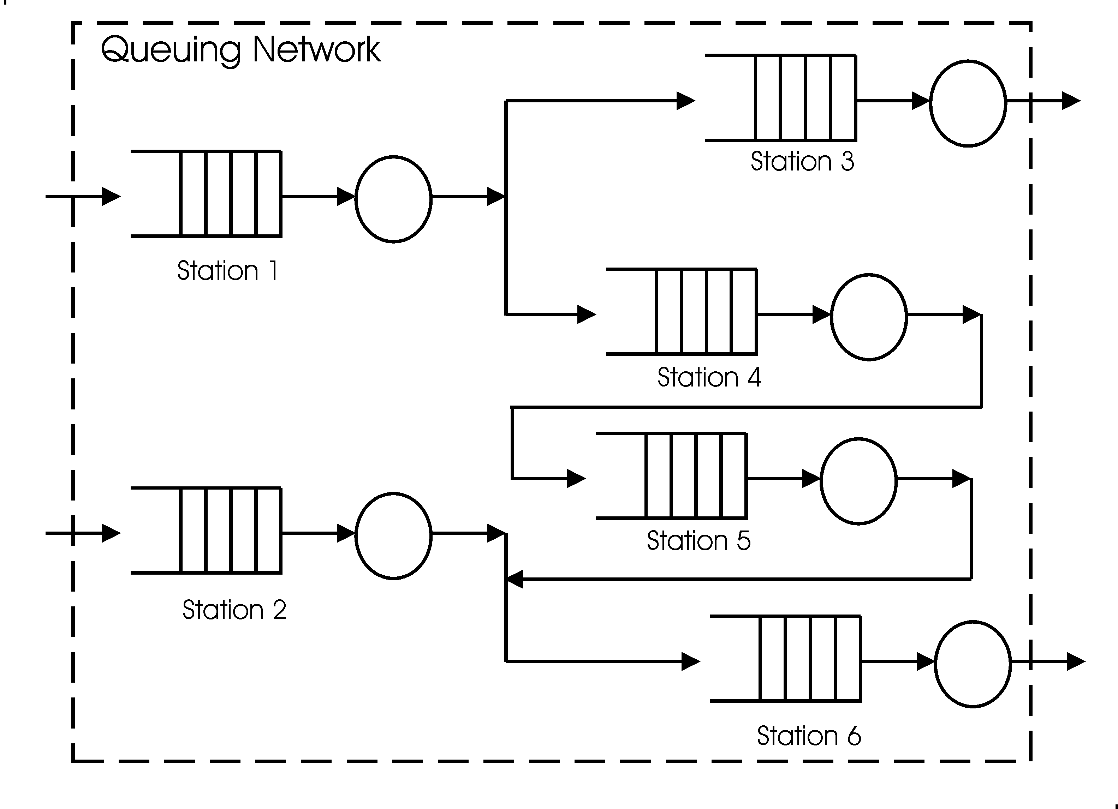
A Queuing Network

Slide 48
Results of a Simulation Run
Two text files are normally generated by a simulation run:
The trace file, which is the sequence of events that occur during the simulation run
The statistics file that includes performance measures for every priority:
Throughput
Average wait period
other measures

Slide 49
Questions?
Send me any questions you have!
Put them into the Teams Group.

